Slide 1

Advisor Personas
December 15,2017
V 0.011

Slide 2
introduction
Table of Contents
# | Chapter | Page Title
3 | Introduction | Project Overview and Approach
4 | Discovery | Observations – Key Notes
5 | Discovery | Observations – User Interviews
6 | Discovery | Observations – Contextual Inquiry
7 | Discovery | Observations – Contextual Inquiry (continued)
8 | Definition | User Archetypes
9 | Definition | User Personas
10 | Definition | User Persona – Internalist
11 | Definition | User Persona – Maintainist
12 | Definition | User Persona – Generalist
13 | Definition | User Persona -- Activist
14 | Definition | Observations – Themes
15 | Definition | Observations – Goals
16 | Definition | Observations – Goals (continued)
17 | Definition | Observations – Goals (continued)
18 | Definition | Observations – Decision Matrix (example)

Slide 3
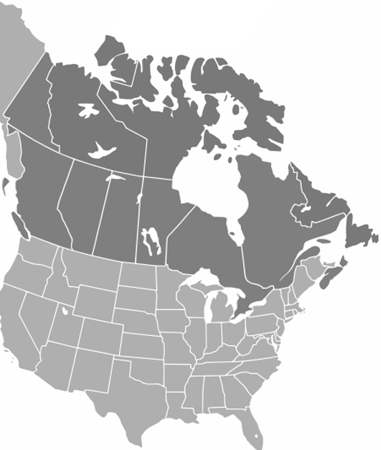
introduction
Project Overview and Approach
Background
RBC has asked the Roundarch Isobar to assist in creating a set of personas and scenarios for the following set of users based on user observations and interviews:
• Investment Advisors
• Associate Advisors
• Associates
Project Approach
The design team will be conducting user research activities, utilizing contextual inquiry practices.
During this discovery process the team will observe and interview a select group of participants and subject matter experts . These participants will be located in varying business centers across three (3) Canadian provinces in order to ensure that the full range of advisor activities are captured and documented.
The above mentioned process will allows the team to capture what the participants want to share and how that aligns with what they actually do. These findings will help to inform the final deliverables for the outcome of this initiative.
Leveraging Experienced Insights
An important component of the approach is the involvement of subject matter or domain experts. These individuals represent a wealth of institutional knowledge that, properly leveraged, can critically inform research findings.
While the primary component of our design process is individual user inquiry, SME insights and observations are useful in two capacities. First, they can ground the research teams’ understanding and quickly establish the business context in which research subjects are operating. Second, and perhaps more importantly, they provide a limited conduit to a much larger audience than can be directly interviewed within the scope of a typical research inquiry. By leveraging SME insights to vet the core issues confronting clients we can further inform and refine our findings to better prioritize or emphasize critical components.
Domain Experts
In line with this approach, the research team will take advantage of all opportunities to sit down with a variety of associates and investment advisory professionals during the user research process.
This process provides real-life insights and experiences, while in that evolve s our understanding of the business context and any specific strategies at play across the business landscape.
The result of this information contextualizes our research and will serve as reference material for our qualitative analysis.
Calgary 
Montreal 
Toronto 

Slide 4





Observations – Key Notes
What we heard from …
INVESTMENT ADVISORS.
ASSOCIATE INVESTMENT ADVISORS.
transactional.
administrative.
“Jumping around from program to program is quite cumbersome. And time consuming. Having the systems “talk “ to one another would help a lot.”*
“The client list is the heart of the business. We need a better way to manage the clients and synchronize our CRM across platforms and devices.”
“Notes need to be manageable and synced. We are in an industry of taking notes for everything.”*
“I use Berton and BTS. They’re faster and easier to use.”
“I didn't know Trade Link/ Client Link could do that?”
“Trade Link is great, but I need to be able to trade FI.”
“I use paper to track a lot of things: printouts of reports and trade tickets, notes on client calls, etc.”*
“I spend a lot of time updating information in multiple systems. I wish I could make updates in a single system, specifically client information.”
“I manage my tasks in Outlook and a hand written list.”
*sentiments shared across all three user roles.

Slide 5




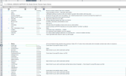

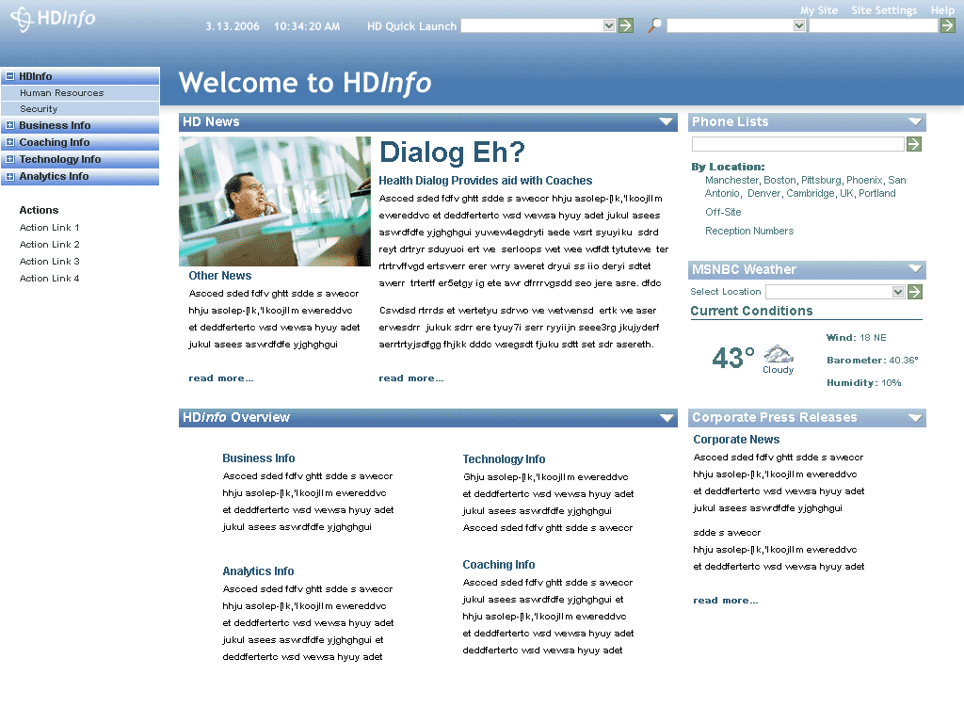
Observations – User interviews
Asking questions to elicit a response.
ACTIVITIES …
review and validate transactions and client data (MRGD, debits, maturing issues, etc.)
client management (add, edit, and delete)
task management and reminders of daily activities
execute trades (equity, fixed income, options, mutual funds, foreign exchange, etc.)
submit new issue interest and allocate positions
account administration (cheques, account setup, transfers, etc.)
portfolio management (reviews, rebalancing, risk management, etc.)
client communications (inquiries, updates, meetings, research, newsletters, periodical reposts, etc.)
client reporting (family snapshots, quarterly and annual reports, etc.)
document management (compliance forms, KYC maintenance, etc.)
account management (house holding, rebalancing, etc.)
managing communications (emails, notes and post-call/meeting follow-up.
market research and distribution.
business management (prospecting, managing existing relationships, etc.)
… GENERAL REACTIONS …
there are many applications to switch between and too many passwords to remember.
there are too many steps to do simple things like find documentation and forms, send out emails to distribution lists, check documentation status, etc.
I feel like there are a lot of features in these programs that I just don’t know about or how to use.
we have a few special cases that aren’t accommodated by the applications so we came up with our own way to handle them.
information across applications can be disparate and I don’t always trust Trade Link or Client Link data.
there is no single location to manage and access client information.
… AND WE NEED TO ADDRESS.
functional and design consistency across applications.
system sign-on and reduce the number of distinct user credentials.
reducing task redundancy across applications and user workflows.
consolidation of data, system synchronization and information consistency.
customized alerts and messaging.
corporate communications and product training.
mobility and the ability to access information and application remotely.
Artifacts
Intranets and Extranet

Slide 6
Observations – contextual inquiry
Observing users performing routine tasks.
VALIDATING TRANSACTIONS.
Print off every trade confirmation to follow up on settlement dates.
Adoption:
High
Run and print the MRGD report to check for errors against a transaction list in Berton before he market opens.
Adoption:
High
Manually review each account to ensure cash is available to cover debits.
Adoption:
High
Print off every transaction as a reminder to validate the task is completed.
Adoption:
Medium
Frequency:
Daily
Frequency:
Daily
Frequency:
Daily
Frequency:
Daily
OPPORTUNITES.
Present the users with immediate access to trade status and transaction data.
Provide users with workflow functionality that allows them to monitor and validate the transactions.
Provide users with the confidence that information is accurate and up-to-date, across multiple data sources.
Introduce additional validation process when executing transactions and notify users of their status (e.g. status alerts, confirmation dialogues, etc.)
Introduce a single interface that automatically maps transaction data with account information.
Allow relative entity data to be presented in in the context of a single entity (e.g. transaction information exposed in client profiles, account information exposed in the context of a transactions, etc.)
Provide users with the ability to “pin” transactions to a workflow process and assign status dates.
DATA LOOK UP.
Access multiple applications to validate the accuracy of data.
Adoption:
High
Lookup identifiers (accounts, securities, etc.) in one application and the details in another.
Adoption:
High
Difficulty locating specific information and looks to colleagues for help.
Adoption:
Medium
Frequency:
Intra-Daily
Frequency:
Intra-Daily
Frequency:
Intra-Daily
OPPORTUNITES.
Retire redundant applications and processes.
Provide user with consistent and accurate information that is accessible across multiple applications.
Present related entity information in the context of the active application.
Provide users with unique views of information based on their roles, motivations and the application being accessed. (e.g. information hierarchy of relative data).
Introduce robust search and filtering tools.
Introduce detailed help libraries and instructional resources.

Slide 7
Observations – contextual inquiry (continued)
Observing users performing routine tasks.
DATA MANAGEMENT.
Users need to update the same information in multiple systems (e.g. client profiles).
Adoption:
High
Data is inconsistent across applications and difficult to manage.
Adoption:
High
Users often maintain physical file of account and client information.
Adoption:
High
Frequency:
Daily
Frequency:
Daily
Frequency:
Daily
OPPORTUNITES.
Present the users with trade status and transaction data as a priority and is easy to consume.
Provide users with workflow functionality that allows them to monitor and validate the transactions.
Ensure that data is consolidated and synced across all systems.
Normalize information models for each entity that will ensure consistent data set and increase finadability.
Enhance the usability of the data management both in input timeliness and interaction consistency.
TASK MANAGEMENT.
Use note pads or Outlook (emails and tasks) as a reminder of tasks to be completed for the next day.
Adoption:
High
Users want to be reminded of tasks and alerted when particular actions take place.
Adoption:
High
Frequency:
Daily
Frequency:
Daily
OPPORTUNITES.
Introduce work flow for task management to assign, delegate and monitor tasks within the team.
Provide the ability to set custom alerts or triggers when data thresholds are met.
Expose alerts and messages in a single location that is always in view to trigger task management.

Slide 8
definition – User archetypes
Classifying the user motivations and tasks into discrete archetypes.
Identifying the Users
The first step in defining the solution is identifying the users. Categorizing the users in groups helps us identify their key motivations. Further analysis defines the archetypes which expose specific behaviors and helps identify their needs. Adding a personal identity to the user types yields the persona, a tool used to bring us a sense of familiarity to address their needs in the real world.
What is and Archetype?
An archetype is a construct, like a template, that helps us to understand what users see and to create a structured environment for analysis.
Archetypes provide a clear vision of the needs of your audience, outlining the broader masses of what you are dealing with organizationally that can help organizational leaders make strategic decisions.
MAINTAINIST:
Typically provides advisor support with limited trading responsibilities and extensive administrative experience.
Key Attributes
Organized and efficient
Licensed to trade
Strong communicator
Comfortable making low impact decisions
Key Informational Needs
Client profile and portfolio information (active and historical)
Market data and commentary
Active and historical trade data
GENERALIST:
Takes a hands-on approach to trade and portfolio management Actively engages in administrative tasks when necessary.
Key Attributes
Organized and efficient—a master of multitasking
Business oriented
Strong communicator
Licensed to trade
Able to make informed decisions with very little to no oversight
Key Informational Needs
Market data and commentary
Client profile and portfolio information (active and historical)
Prospect information
Active and historical trade data
INTERNALIST:
Responsible for the day-to-day office administrative activities that support the teams trading and wealth management activities.
Key Attributes
Organized and efficient
Attuned to the needs of the team
Strong team player who works well with others
Key Informational Needs
Daily tasks and team calendars
Forms and documentation status
Client profile information (active and historical)
Account management
ACTIVIST:
Strictly focusing on building/maintaining the business, through client relationships and market research and successful portfolio management.
Key Attributes
Strong business building and sales skills
Excellent communicator
Strong leadership and delegation skills
Experienced in making impactful decisions
Critical thinking
Licensed to trade
Key Informational Needs
Market data and commentary
Business analytics
Client profile and portfolio information (active and historical)
Prospecting and lead information
TRANSACTIONAL.
INFORMATIONAL.

Slide 9




definition – User personas
Illustrating user archetypes into identifiable users personae.
What is a persona?
The persona is a characterization of a user type that includes a detailed description of their routines, motivations, and behaviors, allowing us to relate to them as individuals in the real world.
How do we identify the key personas?
Our research process includes capturing our observations and defining user needs. Each need is then mapped as a value to the prospective user archetypes. These needs reveals patterns in the user’s values against specific needs. These patterns help us to determine the key personas and the outlier personas.
Note: Although both discretionary and non-discretionary trading were common, most offices were trending towards the PIMS account management model. It was recognized that the daily routines could require unique activities, but the users motivations and goals were the same (with the exception of bulk trading). As such, the following definitions do not distinguish these activities as a requirement for additional persona representation.
MAINTAINIST
GENERALIST
Persona 2
KEVIN MICHAELS Associate (trader)
“I support our Investment Advisor in all business matters, including client management and communications, but my primary focus is market research and portfolio management.”
Persona 3
KATE STEVENS Associate Advisor
“We are a small team. I support my Investment Advisor any way I can to ensure the business is running smoothly. He appreciates my efforts and trusts me to run the office when he is not around.”
INTERNALIST
ACTIVIST
Persona 1
DEBRAH TAYLOR
Associate (Admin)
“I help to keep the office running. I manage all administrative matters and provide support to the team by keeping accurate account records including managing all documentation and forms.
Persona 4
JAMES CARTER Investment Advisor
“I provided guidance and oversee all matters of running the office. I manage a large book and look to my team to help with keeping us aligned with my investment strategies and ensuring the success of the business is maintained.
TRANSACTIONAL.
INFORMATIONAL.

Slide 10

Definition – User persona 1
ARCHETYPE: Internalist
TECHNICAL PROFICIENCY AND TOOLS:
DEBRAH TAYLOR
TITLE: Associate (Admin) COMPANY: RBC LOCATION: Montreal, QC CURRENT POSITION: 2 yrs. INDUSTRY: 4 yrs CLIENTS SERVED: 45 Households $125M Assets
Berton | Trade Link | Client Source | Message Net | DocuNet | MS Outlook | WSJ
BTS | Client Link | Thompson 1 | RBC Insight | Flex Pak | MS Excel | CNN Money
SCENARIO NARRATIVE (DAILY ROUTINE):
As an Admin, I don’t really have too much input on trading decisions or portfolio management. I really deal more with the day-to-day aspects of the business and help support my team members by handling the tasks that could otherwise interfere with the timely execution of transactions. As a result, I have my hand in several pots and because I get a lot of requests from my team (and our clients) that are somewhat time-sensitive, I need to be able to be efficient in my management of my tasks and daily routines.
Behaviors:
Decision Maker
Influencer Consumer
Transactional
SCENARIO FLOW (DAILY ROUTINE):
8:00am I arrive at the office and I launch the suite of RBC applications.
8:15am I go through my emails and task list to organize my day.
8:30am I run the MRGD report to assist the trading team in validating the previous days transactions and balance debits.
9:00am I run a commission report and walk it over to my IA.
9:15am I Notice a transfer I requested yesterday didn’t go through, so I call the cage to investigate and reconcile before the market opens..
10:00am I spend the remainder of the morning answering and distributing client calls. And adding to my task list.
Noon Go to lunch and grab something to eat.
1:00pm I return to my desk and check my emails and task list.
1:15pm I notice I have multiple cheques that need to go out to clients. I send in the requests and check those tasks off my list.
3:00pm At the end of my day, I make sure that my IA has all client communications and report packages ready for his meeting the following day.
“I AM RESPONSIBLE FOR …”
… handling documentation for clients and making sure it’s complete and meets compliance.
… managing client; requests, communications and meetings.
… prepare client package materials necessary for client meetings.
… creating and maintaining client profiles (e.g. address change, divorce, etc.).
I NEED TO:
Go through Previous day’s transactions and against account debit reports
Download/generate forms and documents for both our clients and internal administrative use
Be aware of and communicate all compliance and regulatory events .
Handle check requests, wire transfers, and occasionally trade mutual funds and GICs
Locate current and historical information for individual client requests.
Ready client reporting packages for quarterly and annual distribution.

Slide 11

Definition – User persona 2
ARCHETYPE: Maintainist
TECHNICAL PROFICIENCY AND TOOLS:
KEVIN MICHAELS
TITLE: Associate (Trader) COMPANY: RBC LOCATION: Calgary, AB CURRENT POSITION: 4 yrs. INDUSTRY: 7 yrs CLIENTS SERVED: 67 Households $150M Assets
Berton | Trade Link | Client Source | Message Net | DocuNet | MS Outlook | WSJ
BTS | Client Link | Thompson 1 | RBC Insight | Flex Pak | MS Excel | CNN Money
SCENARIO NARRATIVE (DAILY ROUTINE):
As an associate trader, I’m licensed to trade and spend a good portion of my day dealing with trades and allocations, but I also help the administrative associate with things like client management, and general information requests from both clients and the advisor. There’s often so much to do that we are both constantly busy and focus on our primary tasks.
Behaviors:
Decision Maker
Influencer Consumer
Transactional
SCENARIO FLOW (DAILY ROUTINE):
7:00am I arrive at the office and I launch the suite of RBC applications.
7:15am I go through my emails and task list to organize my day.
7:30am I run the MRGD report to validating the previous days transactions and balance account debits.
8:00am I ask Debrah (our admin associate) to run the commission report for our IA.
8:15am I refer back to my emails and filter through a list of 3rd party research to locate high priority emails from clients or my IA.
8:45am I receive an email with the new issue report. I print the report and discuss our potential interest with my IA.
8:50am I submit our interest to our front office team.
9:00am From my task list, I decide to follow up on a client request to identify the price for a mature position.
10:00am After completing the request, I call the client back to discuss the results and follow up with an email.
Noon Before I go to lunch, I check the status of our new issue interest. It’s been filled. I decide to take a working lunch as allocating the new issue is timely.
3:00pm At the end of my day, I make sure that my IA has all client communications and review the report packages for his meeting the following day.
“I AM RESPONSIBLE FOR …”
… making trades under the direction of the Investment Advisor and sometimes at the request of the client.
... validating previous day transactions are accurate and completed.
… identifying account debits and freeing up cash to cover.
… forwarding any relevant research, marketing content, and reports to my IA for review and add commentary before we share with our “platinum” clients.
I NEED TO:
Go through previous day’s activity reports to flag any thing unusual for the IA to review.
Go through previous day’s transactions and check against debit reports to balance accounts .
Execute on my IAs decision to show interest in new issues and allocate the position accordingly.
Stay on top of market activity by following internal and external research
Trade on behalf of the Advisor, handling mainly FI transactions.

Slide 12

Definition – User persona 3
ARCHETYPE: Generalist
TECHNICAL PROFICIENCY AND TOOLS:
KATE STEVENS
TITLE: Associate Advisor COMPANY: RBC LOCATION: Toronto, ON CURRENT POSITION: 12 yrs. INDUSTRY: 16 yrs CLIENTS SERVED: 56 Households $150M Assets
Berton | Trade Link | Client Source | Message Net | DocuNet | MS Outlook | WSJ
BTS | Client Link | Thompson 1 | RBC Insight | Flex Pak | MS Excel | CNN Money
SCENARIO NARRATIVE (DAILY ROUTINE):
As an Associate Investment Advisor, I work in tandem with the Advisor. We’re a two person team and I’ve been given a portion of the book to manage. As such, I need to be aware of what is going on in the market so that I can make smart investment decisions and recommendations for my client that are also in line with the vision of my investment advisor.
Behaviors:
Decision Maker
Influencer Consumer
Transactional
SCENARIO FLOW (DAILY ROUTINE):
7:30am I arrive at the office and I launch the suite of RBC applications.
7:45am I go through my emails and task list to organize my day.
8:00am I run the MRGD report to validating the previous days transactions and balance account debits.
8:15am I run the commission report for review with my IA.
8:30am I scan my filtered inbox to review my client communications. I remember that a specific client has an interest in a particular position.
8:45am I do my research and conclude that this clients request is not a good decision.
9:10am I present the request and concluding research to my IA for advice.
9:15am He agrees that it is not the right move.
9:20am I email my finding to my client and follow up with a phone call. He appreciates the feedback.
10:00 return to my emails and task list and research interesting positions that can be entered into our “mock” model.
Noon I grab a quick lunch and spend the remainder of my day taking client calls and capturing conversation note while normalizing the clients information between BTS, Client Link and Outlook.
“I AM RESPONSIBLE FOR …”
... managing a portion of the book, with a select group of clients.
… helping to make decisions for trades that match our overall investment goals and strategies.
… managing all client communications and profile information.
… making sure the business runs smoothly when my IA is not in the office.
I NEED TO:
Have quick access to all information regarding my clients—both profile and transactional information.
Be able to process client and Advisor requests in a timely manner.
Maintain client relationships for the overall success of the business while managing referrals from existing client base.
Manage my own set of clients that represent a portion of the portfolio.

Slide 13

Definition – User persona 4
ARCHETYPE: Activist
TECHNICAL PROFICIENCY AND TOOLS:
JAMES CARTER
TITLE: Investment Advisor COMPANY: RBC LOCATION: Toronto, ON CURRENT POSITION: 8 yrs. INDUSTRY: 23 yrs CLIENTS SERVED: 212 Households $650M Assets
Berton | Trade Link | Client Source | Message Net | DocuNet | MS Outlook | WSJ
BTS | Client Link | Thompson 1 | RBC Insight | Flex Pak | MS Excel | CNN Money
SCENARIO NARRATIVE (DAILY ROUTINE):
As a Advisor, I am directly accountable for the success of my business, my team and making money for my clients. I am responsible for all major decisions that will impact the overall performance of each portfolio in our book. My clients are the business. I need to stay up-to-date on their personal and financial situations in order to successfully manage their wealth.
Behaviors:
Decision Maker
Influencer Consumer
Transactional
SCENARIO FLOW (DAILY ROUTINE):
7:00am I check my emails and see what’s on my calendar for meetings.
7:30am I read the rooster and other research. I e-mail my associate and ask him to identify our exposure to security ABC. After review of the client portfolios, I instruct the associate to contact a prioritized list of clients to inform them of our response to the exposure.
8:30am My associate hands me the highlights of the MRGD and debit reports. I go through these and make some notes for him with action to take.
8:45am My admin associate delivers the commission report for me to review.
9:00am I’m reminded that I have a meeting at 10am with a “platinum” client.
9:30am After thorough review of the portfolio and clients notes, I huddle with my team to discuss key topics to review with the client, both personal and financial.
10:05am The client arrives and we sit down to discuss their situations.
Noon I take the client to lunch at my golf club.
3:00pm I return to the office to review today’s market activity while sifting through a stack of portfolios that require my attention.
4:45pm I finish up my day, sending emails to a few of my non-PIM clients with trade ideas for tomorrow.
“I AM RESPONSIBLE FOR …”
... defining the overall investment strategy and direction of the business.
… managing my associates and ensuring that they are contributing to the team in an effective manner.
… maintaining relationships with our “platinum” clients while proactively generating relationships with prospective clients.
… making sure our exposure is not at risk and planning for market trends.
I NEED TO:
Have quick access to all information regarding my clients, both profile and transactional information, ideally when I’m on the go.
Have an accurate account of all my prospects interactions.
Be able to assign tasks to my associates in an efficient manner.
Have up-to-date access to active securities, my watch lists and overall market trends.

Slide 14
definition – themes
Categorizing our findings into common themes.
1
2
3
4
5
6
Information
Access and Design
Making information easily accessible, with intuitive interfaces that is relevant the user ‘s needs through a logical content and navigation.
Customization and Collaboration
Allow users to become more proactive in an environment where information is readily available, customizable and easily shared with other users.
Integration and Synchronization
Assimilate data into a structured environment allowing users to access, manage and distribute information in a consistent manner.
Alerting and
Messaging
Deliver accurate, real-time alerts and notifications that are specific to, or can be customized for, a variety of users needs.
Process Management
and Training
Provide the ability to assign and track activities for workflows of routine tasks, while introducing organizational best-practices and training.
Reporting and
Analytics
Enhance the existing capabilities based on specific user needs for the purposes of generating accurate and consistent data presentations.

Slide 15
definition – goals
Extracting goals from the common themes.
1
2
Provide single sign-on. For multiple systems.
Provide mobile and remote access to systems and data .
Remove feature and data redundancy by retiring legacy systems.
Adhere to consistent RBC branding and functional capabilities.
Present information and functionality that is necessary to complete a users task in a single interface (e.g. trade information initiating message net).
Consolidate and normalize legacy and new across all systems.
Present the users with immediate access to trade status and transaction data (e.g. dashboard screen).
Introduce a single interface that automatically maps transaction data with account information (e.g. when looking at a client account, provide a view into transaction history or trade status)
Allow related entity data to be presented in in the context of a single entity (e.g. transaction information, meeting information, meeting notes, etc. exposed in client profiles).
Provide user with consistent and accurate information that is accessible across multiple applications.
Introduce robust search and filtering tools.
Provide the ability to distribute tasks and workflows across team members.
Allow users to customize system data displays to satisfy their specific needs.
Allow users to generate individual, customized reporting packages.
Allow users to create customized dashboard views of data that is relevant to their roles and user entitlements.
Provide users with unique views of information based on their roles, motivations and the application being accessed. (e.g. information hierarchy of relative data – managers have access to more information in trade related applications vs. admin associates have more access to documentation and client management).
Information
Access and Design
Making information easily accessible, with intuitive interfaces that is relevant the user ‘s needs through a logical content and navigation.
Customization and Collaboration
Allow users to become more proactive in an environment where information is readily available, customizable and easily shared with other users.

Slide 16
definition – goals (continued)
Extracting goals from the common themes.
3
4
Normalize and consolidate disparate, siloed system data.
The system should allow users to contribute content in a controlled manner instituting a Governance model to oversee and normalize information.
Allows users to access consistent and accurate information relevant to each system.
Provide users with the confidence that information is accurate and up-to-date, across multiple data sources.
Retire redundant applications and processes.
Ensure that data is consolidated and synced across all systems.
Normalize information models for each entity that will ensure consistent data set and increase finadability.
Introduce CRM capabilities (stand-alone or integrated) that provided the ability to centrally store client information while managing and distributing the information across multiple systems.
Provided real-time, 3rd party data integration into RBC systems.
Introduce new, and enhance existing in-application alerts that are relevant to specific events (e.g. watchlists, trade status, etc.) and routinely executed activities (e.g. maturing funds, client management, etc.).
Provide users with the ability to “pin” transactions to a workflow process and assign status dates.
Present the users with trade status and transaction data as a priority and is easy to consume.
Provide the ability to set custom alerts or triggers when data thresholds are met.
Expose alerts and messages in a single location that is always in view to trigger task management.
Integration and Synchronization
Assimilate data into a structured environment allowing users to access, manage and distribute information in a consistent manner.
Alerting and
Messaging
Deliver accurate, real-time alerts and notifications that are specific to, or can be customized for, a variety of users needs.

Slide 17
definition – goals (continued)
Extracting goals from the common themes.
5
6
Provide the ability to manage and track tasks and workflows across team members.
Provide users with institutional best practices on how to execute routine tasks with consistent results.
Introduce a program that provides in-depth training on applications features and functionality.
Provide users with workflow functionality that allows them to monitor and validate the transactions.
Introduce additional validation process when executing transactions and notify users of their status (e.g. status alerts, confirmation dialogues, etc.).
Introduce detailed help libraries and instructional resources.
Enhance the usability of the data management both in input timeliness and interaction consistency across all systems (e.g. BTS and Berton is quick and accurate, Tradelink and Client Link need to be the same).
Provided the ability to execute bulk trades and allocation in a single interface.
Introduce robust business analytics beyond fees and commissions earned (e.g. benchmarked against firm’s top earners)
Educate users on executing existing reporting capabilities.
Provide users with robust reporting and packing capabilities that align to their clients needs.
Allow users to monitor performance metrics specific to each teams business goals.
Process Management
and Training
Provide the ability to assign and track activities for workflows of routine tasks, while introducing organizational best-practices and training.
Reporting and
Analytics
Enhance the existing capabilities based on specific user needs for the purposes of generating accurate and consistent data presentations.

Slide 18
Definition – Decision Matrix (example)
Prioritization goals to define opportunities.
The following is an example of prioritizing the goals into a phase plan.
Each goal is assessed against its business/user value and the design/technical readiness to deliver. Low value items are monitored and deemphasized from vision scope.
11
PLAN
ACT
27
32
20
12
1
2
10
24
21
14
4
25
22
3
High Value
17
34
8
9
16
15
28
Low Readiness
High Readiness
MONITOR
CONSIDER
30
18
19
5
29
31
33
Low Value
7
36
26
27
6
35
13

